Slide 1
Sudoku
Project 5, Group 6
By: Elvin Carranza, Riley Payung, and Jenny Smiley

Slide 2

Theory

Slide 3
Approach
113 operations used to transform the final puzzle into the trivial puzzle
Final Puzzle
Trivial Puzzle
36 different cell swaps
36 row swaps
36 column swaps
3 different rotations
2 different flips

Slide 4
Measure of Similarity
Measure of Similarity
Puzzle
Trivial
!=
Similarity score plus 1
Returns the number of mismatched cells

Slide 5
Code

Slide 6
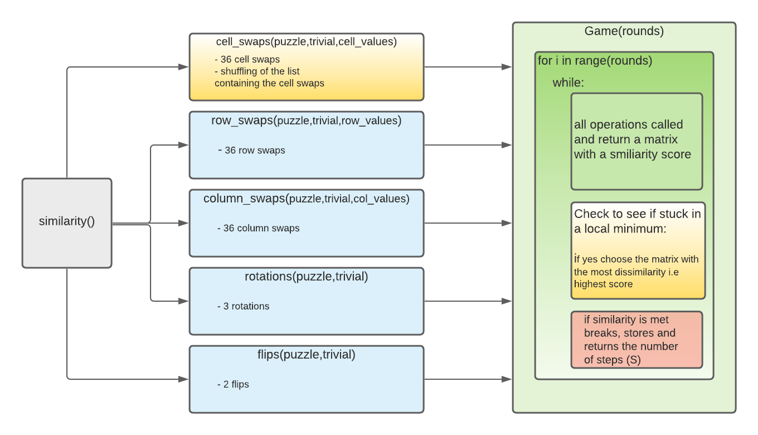
Functions Created

Slide 7

Results
Notes:
My name is Riley Payung and I will be doing the results section of this presentation.

Slide 8
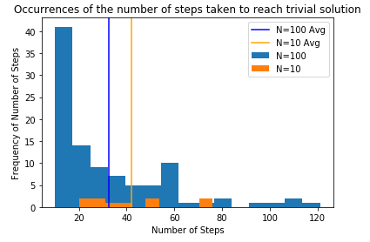
Results of N=10,100 Games
N = 10 in Orange
N = 100 in Blue
Average of N=10: 42.2
Average of N=100: 32.56
Notes:
As can be seen on this slide, As the number of boards increases, the average number of steps decreases, since we can see almost a 10 step drop in the number of steps taken when N=100 as opposed to N=10. The averages can be seen in the graph as the blue line for N=100 and the orange line for N = 10. This will be useful in the next slide.

Slide 9
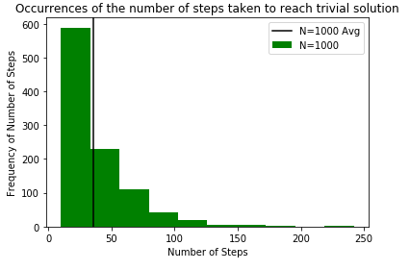
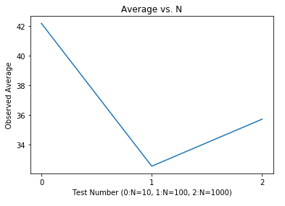
Increase in game size
Avg of 1000 games: 35.731 steps
Notes:
Based on the averages from last slide, we can see here that the increase in the number of games did not follow the same trend of going down as the number of samples increase; instead, it increased. This is because as the number of samples increases, we will get closer and closer to our expected average. The average steps for 1000 games was 35.731. In the plot on the right, we can see the average of three sample sizes plotted, where 0 is 10, 1 is 100, and 2 is 1000 games respectively.

Slide 10
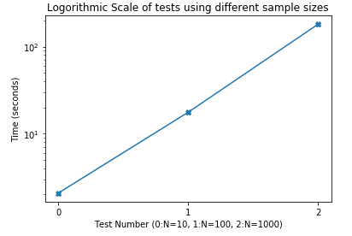
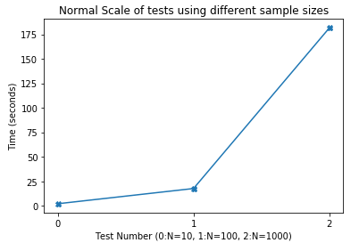
Time Complexity based on steps taken
Notes:
The time complexity of the sudoku solver increased by a logarithmic scale in the number of seconds taken to complete the number of necessary puzzles. This was expected as the sample sizes also increases logarithmically. The normal scale is there for scale. Thank you for watching our presentation.

